Slide 1
Python Packages

Slide 2

Roadmap
Array Data Structure
Data Visualization
Pandas

Slide 3


Array Data Structure
“Fighting with a large army under your command is nowise different from fighting with a small one: it is merely a question of instituting signs and signals.”
–Sun Tzu on the Art of War

Slide 4
Array Data Structure
Concepts
One-dimensional arrays
Final exam grades of six students
 |  |  | Length is 6
61 | 52.5 | 71 |  | 32.5 | 68 |  | 64
6 students
Length is 6
71 32.5 68
61 52.5
64
Index of the item is 2

Slide 5
Array Data Structure
Concepts
Two-dimensional arrays
Grades of three components of six students
 | 3 columns
18 |  | 26 | 71
25 |  | 15.5 | 12
24 |  | 27 | 20
10 |  | 5.5 | 17
27 |  | 26 | 15
22 |  | 21 | 21
 | 3 columns
18 | 26 | 71
25 | 15.5 | 12
24 | 27 | 20
10 | 5.5 | 17
27 | 26 | 15
22 | 21 | 21
6 rows
6 rows
Row index is 3 Column index is 2
6 students

Slide 6
Array Data Structure
Concepts
N-dimensional arrays
3 columns
18 | 26 | 71
25 | 15.5 | 12
24 | 27 | 20
10 | 5.5 | 17
27 | 26 | 15
22 | 21 | 21
Length is 6
rows 6
61 52.5
Index of the item is 2
71 32.5 68 64
One-dimensional array
Row index is 3 Column index is 2
with 6 items
Two-dimensional array
with
6 × 3 = 18 items
Dimension number | Shape | Index | Item number
1
2
N
One number Two numbers
N numbers
One index Two indexes
N indexes
Shape
Shape[0] * Shape[1]
Shape[0] *…* Shape[N]

Slide 7

Array Data Structure
NumPy arrays
Import the NumPy package
import numpy as
.<function
np
np
name>

Slide 8
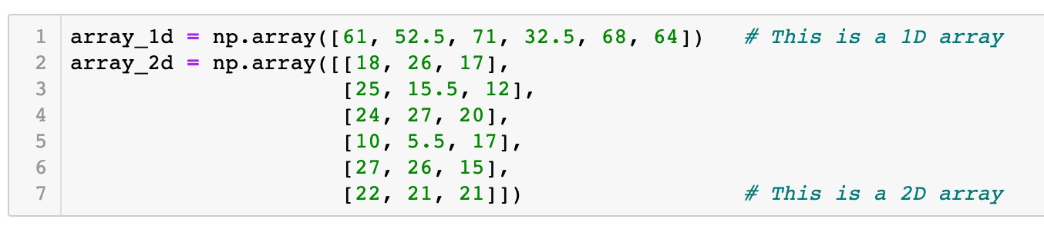
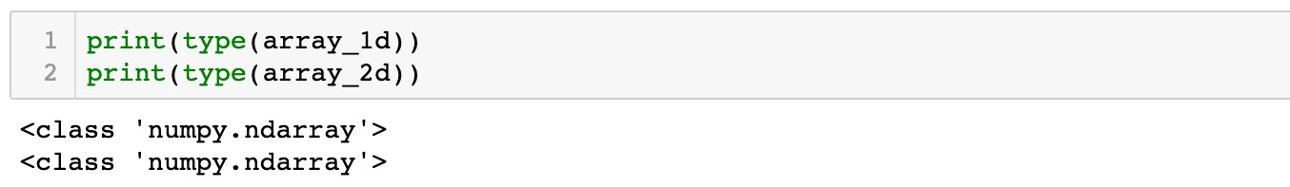

Array Data Structure
NumPy arrays
Create arrays from Python lists
Function
np.array()

Slide 9

Array Data Structure
NumPy arrays
Create arrays from Python lists
Function
np.array()
61 | 52.5 | 71 | 32.5 | 68 | 64

Slide 10
Array Data Structure
NumPy arrays
Create arrays from Python lists
Function
np.array()
18 | 26 | 71
25 | 15.5 | 12
24 | 27 | 20
10 | 5.5 | 17
27 | 26 | 15
22 | 21 | 21

Slide 11
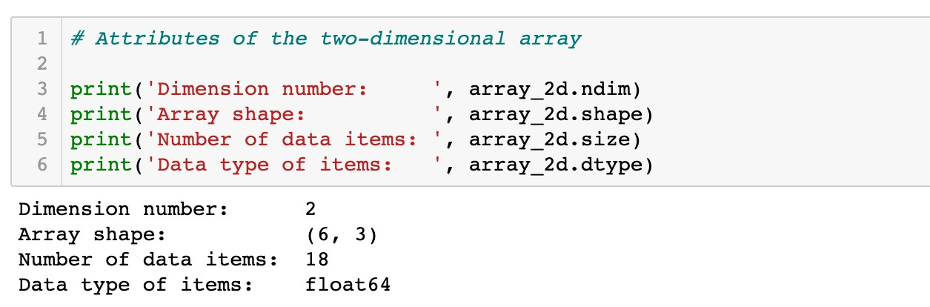
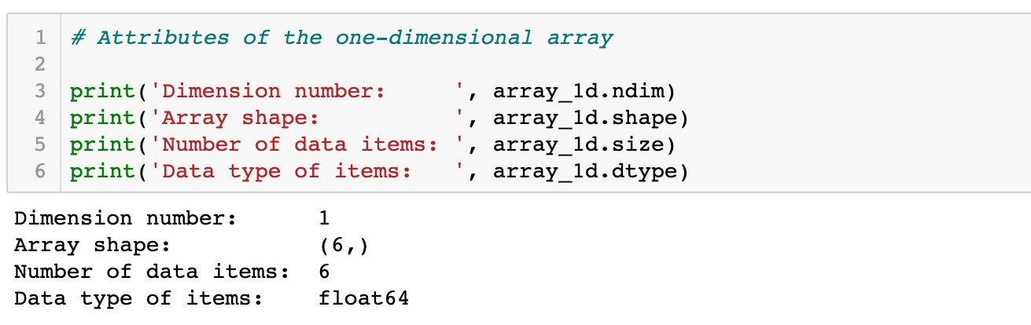
Array Data Structure
NumPy arrays
Create arrays from Python lists
Attributes of arrays

Slide 12

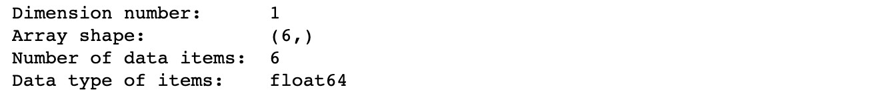
Array Data Structure
NumPy arrays
Create arrays from Python lists
Attributes of arrays
 |  | Length is 6
61 | 52.5 |  | 71 | 32.5 | 68 |  | 64
One-dimensional
array with 6 items

Slide 13
Array Data Structure
NumPy arrays
Create arrays from Python lists
Attributes of arrays
Length is 6
61 52.5
71 32.5 68 64
One-dimensional array
with 6 items
A tuple with one item

Slide 14

Array Data Structure
NumPy arrays
Create arrays from Python lists
Attributes of arrays
 |  | Length is 6
61 | 52.5 |  | 71 | 32.5 | 68 |  | 64
One-dimensional array
with 6 items

Slide 15
Array Data Structure
NumPy arrays
Create arrays from Python lists
Attributes of arrays
 |  | Length is 6
61 | 52.5 |  | 71 | 32.5 | 68 |  | 64
One-dimensional array
with 6 items
Data type: floating point numbers

Slide 16
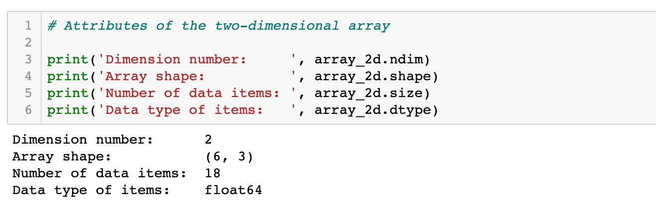
Array Data Structure
NumPy arrays
Create arrays from Python lists
Attributes of arrays

Slide 17
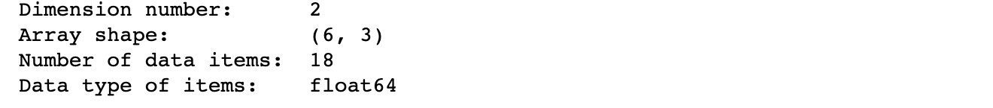
Array Data Structure
NumPy arrays
Create arrays from Python lists
Attributes of arrays
 | 3 columns
18 |  | 26 | 71
25 |  | 15.5 | 12
24 |  | 27 | 20
10 |  | 5.5 | 17
27 |  | 26 | 15
22 |  | 21 | 21
6 rows
Two-dimensional
array with 6 × 3 = 18 items

Slide 18


Array Data Structure
NumPy arrays
Create arrays from Python lists
Attributes of arrays
3 columns
18 |  | 26 | 71
25 |  | 15.5 | 12
24 |  | 27 | 20
10 |  | 5.5 | 17
27 |  | 26 | 15
22 |  | 21 | 21
ows r
6
Two-dimensional array with 6 × 3 = 18 items
axis 0

Slide 19

Array Data Structure
NumPy arrays
Create arrays from Python lists
Attributes of arrays
3 columns
18 | 26 | 71
25 | 15.5 | 12
24 | 27 | 20
10 | 5.5 | 17
27 | 26 | 15
22 | 21 | 21
ows r
6
Two-dimensional array with 6 × 3 = 18 items
axis 1

Slide 20

Array Data Structure
NumPy arrays
Create arrays from Python lists
Attributes of arrays
 | 3 columns
18 |  | 26 | 71
25 |  | 15.5 | 12
24 |  | 27 | 20
10 |  | 5.5 | 17
27 |  | 26 | 15
22 |  | 21 | 21
6 rows
Two-dimensional array
with 6 × 3 = 18 items

Slide 21
Array Data Structure
NumPy arrays
Create arrays from Python lists
Attributes of arrays
 | 3 columns
18 |  | 26 | 71
25 |  | 15.5 | 12
24 |  | 27 | 20
10 |  | 5.5 | 17
27 |  | 26 | 15
22 |  | 21 | 21
6 rows
Two-dimensional array with 6 × 3 = 18 items
Data type: floating point numbers

Slide 22
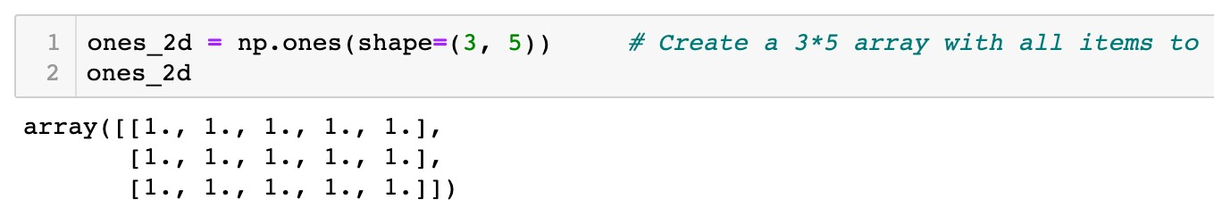
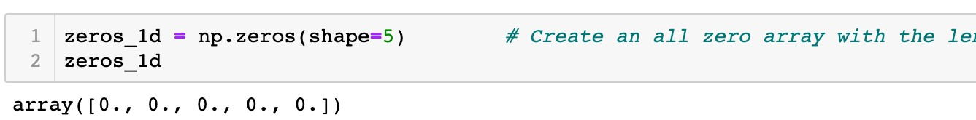
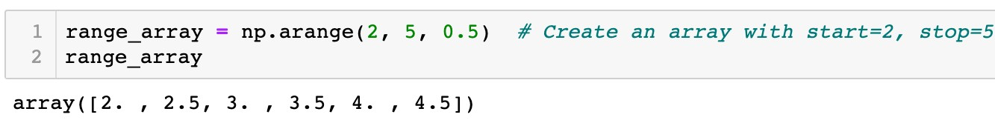
Array Data Structure
NumPy arrays
Create special arrays
A two-dimensional array: 3 rows and 5 columns
A one-dimensional array: length is 5
(start, stop, step)

Slide 23
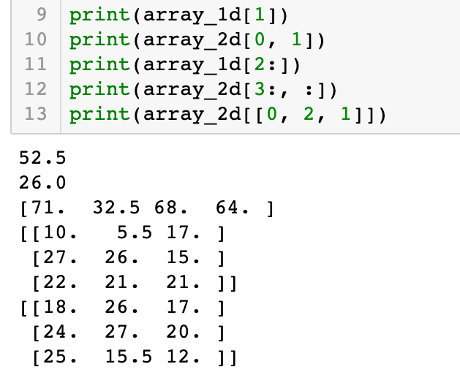
Array Data Structure
NumPy arrays
Indexing and slicing of arrays
Similar to type data
list
61 | 52.5 | 71 | 32.5 | 68 | 64
Index: 1

Slide 24
Array Data Structure
NumPy arrays
Indexing and slicing of arrays
Similar to type data
list
Row index: 0
Column index:1
18 | 26 | 71
25 | 15.5 | 12
24 | 27 | 20
10 | 5.5 | 17
27 | 26 | 15
22 | 21 | 21

Slide 25
Array Data Structure
NumPy arrays
Indexing and slicing of arrays
Similar to type data
list
61 | 52.5 | 71 | 32.5 | 68 | 64
Index: 2:6:1

Slide 26
Array Data Structure
NumPy arrays
Indexing and slicing of arrays
Similar to type data
list
18 | 26 | 71
25 | 15.5 | 12
24 | 27 | 20
10 | 5.5 | 17
27 | 26 | 15
22 | 21 | 21
Row index: 3:6:1
Column index: 0:3:1

Slide 27
Array Data Structure
NumPy arrays
Indexing and slicing of arrays
Similar to type data
list
18 | 26 | 71
25 | 15.5 | 12
24 | 27 | 20
10 | 5.5 | 17
27 | 26 | 15
22 | 21 | 21
Row index: [0, 2, 1]
Column index: 0:3:1

Slide 28
Array Data Structure
NumPy arrays
Indexing and slicing of arrays
Similar to type data
list
18 | 26 | 71
25 | 15.5 | 12
24 | 27 | 20
10 | 5.5 | 17
27 | 26 | 15
22 | 21 | 21
Row index: [0, 2, 1]
Column index: 0:3:1
Take all columns if column index is no specified

Slide 29
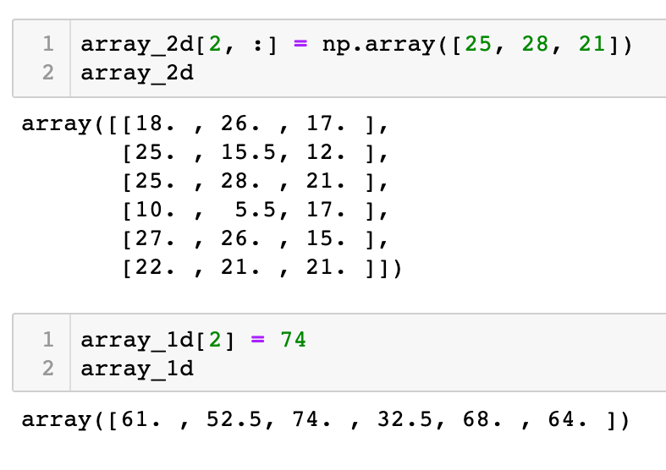
Array Data Structure
NumPy arrays
Indexing and slicing of arrays
Similar to type data
list
18 | 26 | 71
25 | 15.5 | 12
24 | 27 | 20
10 | 5.5 | 17
27 | 26 | 15
22 | 21 | 21
Items to be changed

Slide 30
Array Data Structure
NumPy arrays
Indexing and slicing of arrays
Similar to type data
list
18 | 26 | 71
25 | 15.5 | 12
25 | 28 | 21
10 | 5.5 | 17
27 | 26 | 15
22 | 21 | 21
New item values

Slide 31
Array Data Structure
NumPy arrays
Indexing and slicing of arrays
Similar to type data
list
Item to be changed
61 | 52.5 | 71 | 32.5 | 68 | 64

Slide 32
Array Data Structure
NumPy arrays
Indexing and slicing of arrays
Similar to type data
list
New item value
61 | 52.5 | 74 | 32.5 | 68 | 64

Slide 33
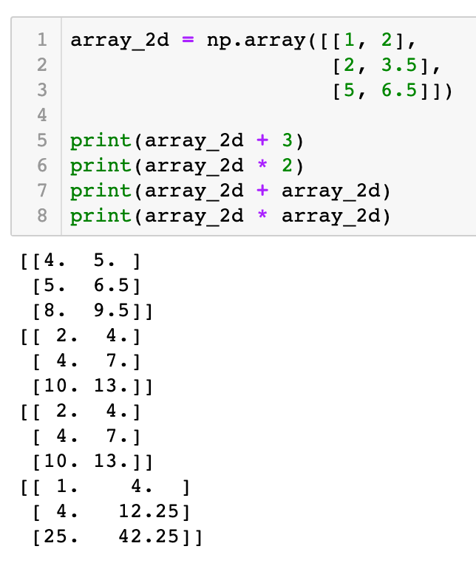
Array Data Structure
NumPy arrays
Element-wise arithmetic operations
An array and a scalar
1 | 2
2 | 3.5
5 | 6.5
4 | 5
5 | 6.5
8 | 9.5
+ 3 =
1 | 2
2 | 3.5
5 | 6.5
2 | 4
4 | 7
10 | 13
* 2 =

Slide 34
Array Data Structure
NumPy arrays
Element-wise arithmetic operations
An array and a scalar
1 | 2
2 | 3.5
5 | 6.5
1 | 2
2 | 3.5
5 | 6.5
2 | 4
4 | 7
10 | 13
+
=
1 | 2
2 | 3.5
5 | 6.5
1 | 2
2 | 3.5
5 | 6.5
1 | 4
4 | 12.25
25 | 42.25
*
=

Slide 35

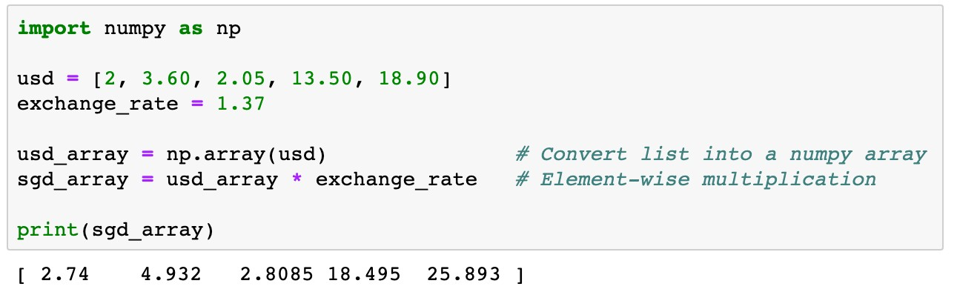
Array Data Structure
NumPy arrays
Element-wise arithmetic operations
Example 1
usd is a list of containing five money transactions in US dollars. Transfer each transaction into Singapore dollars.

Slide 36

Array Data Structure
NumPy arrays
Element-wise arithmetic operations
2 | 3.60 | 2.05 | 13.50 | 18.90

Slide 37

Array Data Structure
NumPy arrays
Element-wise arithmetic operations
2 | 3.60 | 2.05 | 13.50 | 18.90
* 1.37

Slide 38
Array Data Structure
NumPy arrays
Element-wise arithmetic operations
2.74 | 4.932 | 2.8085 | 18.495 | 25.893

Slide 39
Array Data Structure
NumPy arrays
Element-wise arithmetic operations
More concise
Easier to read
Faster to execute than loops

Slide 40
Roadmap
Array Data Structure
Data Visualization
Pandas

Slide 41
Data Visualization

Slide 42

Data Visualization
Data Visualization Packages
Import the Matplotlib package
import
matplotlib.pyplot as
plt
plt
.<function name>
Other package
Plotly
Seaborn

Slide 43

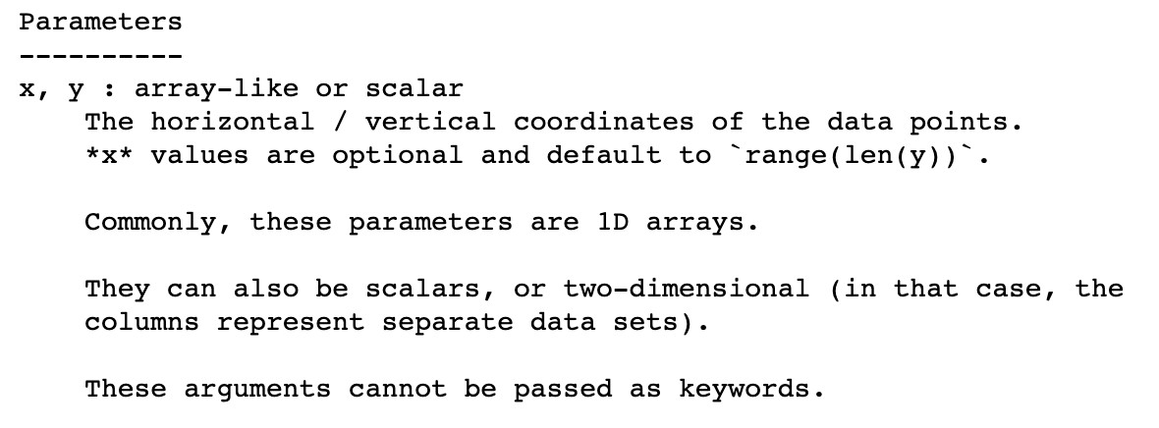
Data Visualization
Functions
Line plot
plot()
,
scatter()
, and
bar()
✓
help()
information of
plot()

Slide 44

Data Visualization
Functions
Line plot
plot()
,
scatter()
, and
bar()
Example 3
Plot the graph of an exponential function y = exp(x), where
x = 0,1,2,3,4,5.

Slide 45
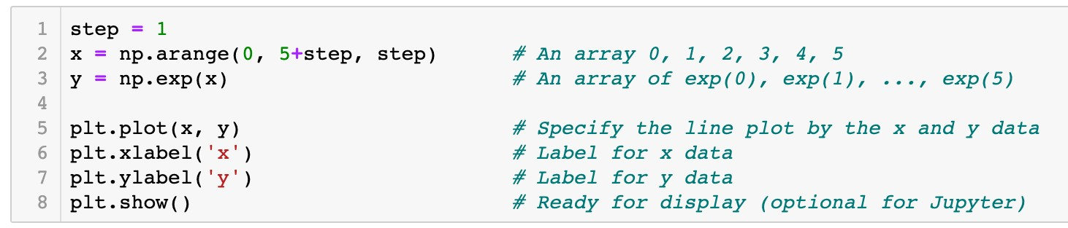
Data Visualization
Functions
Line plot
plot()
,
scatter()
, and
bar()
Example 3
Plot the graph of an exponential function y = exp(x), where
x = 0,1,2,3,4,5.

Slide 46
Data Visualization
Functions
Line plot
plot()
,
scatter()
, and
bar()
x
0 1 2 3 4 5

Slide 47
Data Visualization
Functions
Line plot
plot()
,
scatter()
, and
bar()
x
0 1 2 3 4 5
y
exp(0) exp(1) exp(2) exp(3) exp(4) exp(5)

Slide 48

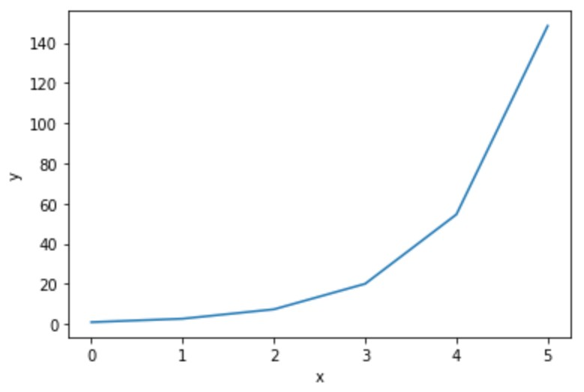
Data Visualization
Functions
Line plot
plot()
,
scatter()
, and
bar()
x
0 1 2 3 4 5
y
exp(0) exp(1) exp(2) exp(3) exp(4) exp(5)
(x[0], y[0])

Slide 49
Data Visualization
Functions
Line plot
plot()
,
scatter()
, and
bar()
x
0 1 2 3 4 5
y
exp(0) exp(1) exp(2) exp(3) exp(4) exp(5)
(x[1], y[1])

Slide 50
Data Visualization
Functions
Line plot
plot()
,
scatter()
, and
bar()
x
0 1 2 3 4 5
y
exp(0) exp(1) exp(2) exp(3) exp(4) exp(5)
(x[2], y[2])

Slide 51
Data Visualization
Functions
Line plot
plot()
,
scatter()
, and
bar()
x
0 1 2 3 4 5
y
exp(0) exp(1) exp(2) exp(3) exp(4) exp(5)
(x[5], y[5])

Slide 52
Data Visualization
Functions
Line plot
plot()
,
scatter()
, and
bar()
x
0 1 2 3 4 5
y
exp(0) exp(1) exp(2) exp(3) exp(4) exp(5)

Slide 53
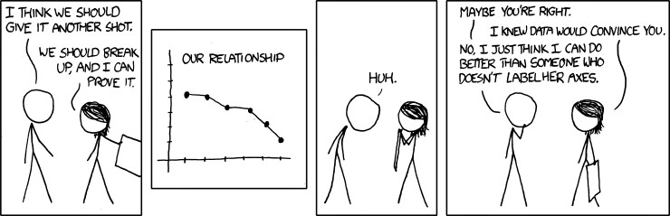
Data Visualization
Functions
plot()
,
scatter()
, and
bar()

Slide 54
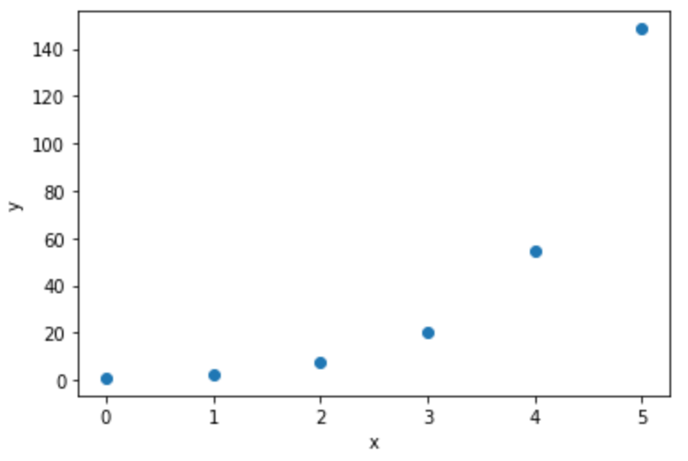
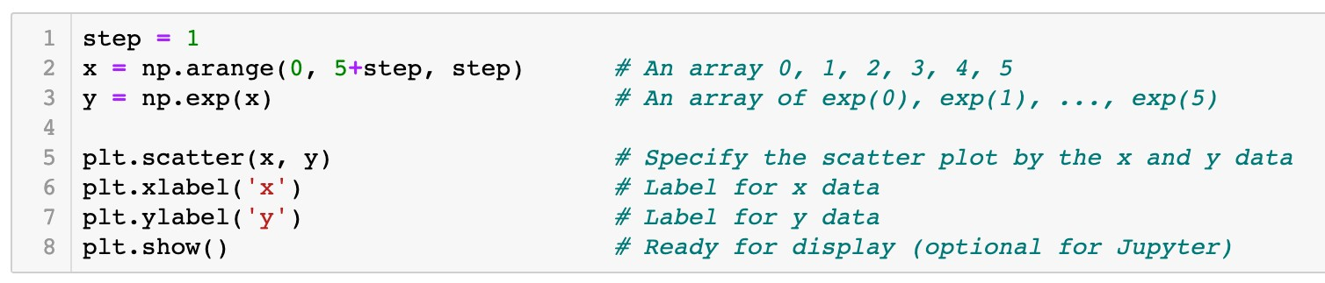
Data Visualization
Functions
plot()
,
scatter()
, and
bar()
Scatter plot
x
0 1 2 3 4 5
y
exp(0) exp(1) exp(2) exp(3) exp(4) exp(5)

Slide 55
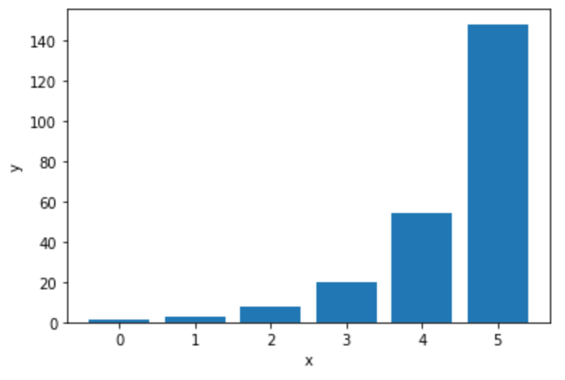
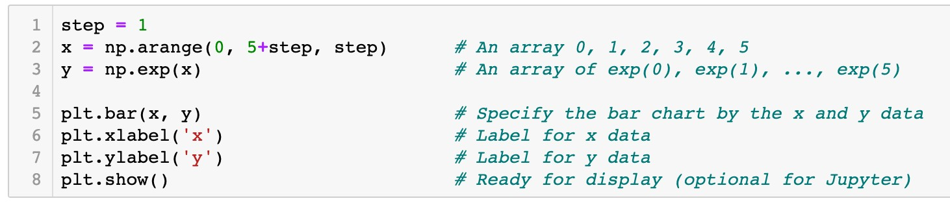
Data Visualization
Functions
plot()
,
scatter()
, and
bar()
Bar graph
x
0 1 2 3 4 5
y
exp(0) exp(1) exp(2) exp(3) exp(4) exp(5)

Slide 56

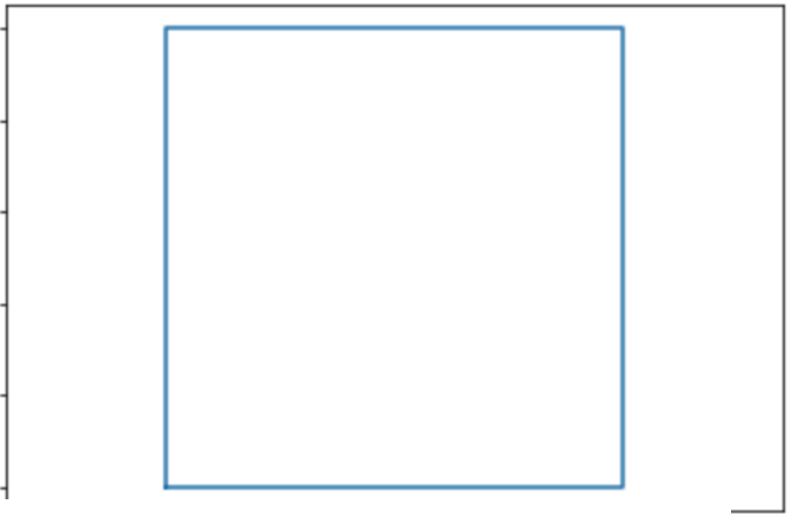
Data Visualization
Question
Which of the following code plots a square as the graph shows?
A.plt.plot([O , 0, 1, 1, O ],
[ 0 '
1, 0, 1, O ])
B. plt.plot([O , 1, 1, 0, O ], _{[ 0 '}
0 , 1, 1, 0 ] )
c. plt.plot([O , 1, 1, 0]' [0'o , 1, 11 )
D. plt.plot([O , 1, 1, O ], [O , 1, 1, O 1 )
LO
08
06
04
02
00
-0 2
00
02 04
06
08 LO
L2

Slide 57
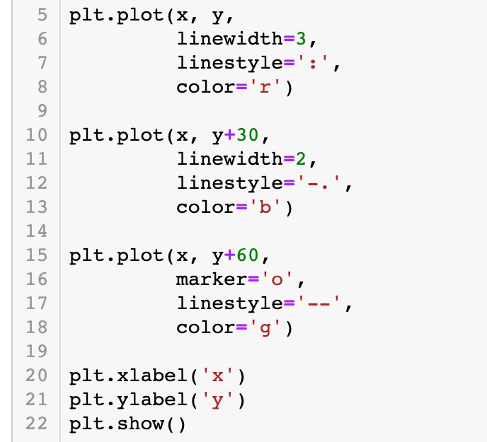
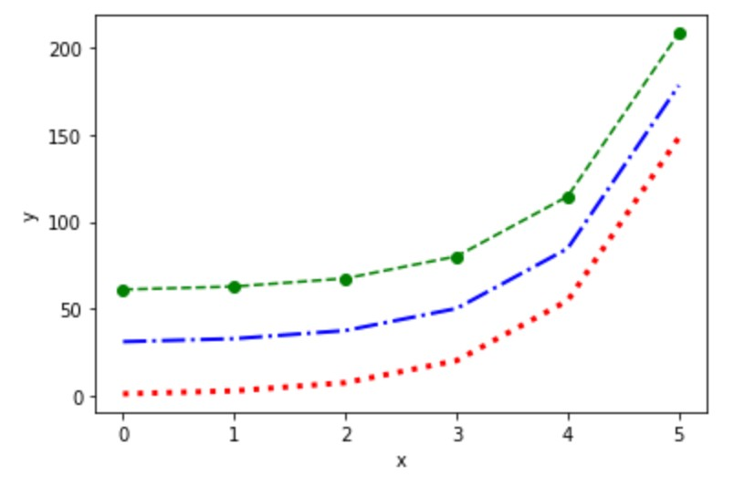
Data Visualization
Configuration of plots and figures
Specify the line plot by keyword arguments

Slide 58
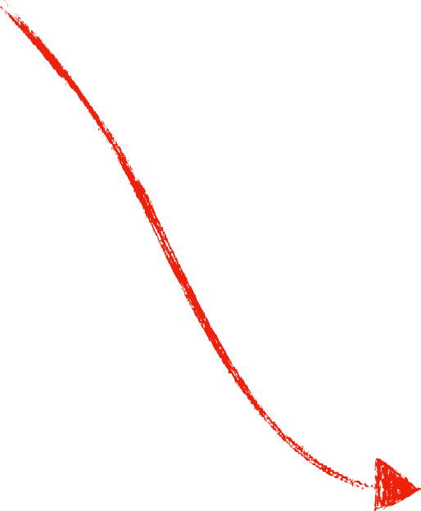
Data Visualization
Configuration of plots and figures
Specify the line plot by keyword arguments
Line width is 3 Dotted line
Line color is red

Slide 59

Data Visualization
Configuration of plots and figures
Specify the line plot by keyword arguments
Line width is 2 Dash-dotted line Line color is blue

Slide 60

Data Visualization
Configuration of plots and figures
Specify the line plot by keyword arguments
Circle marker Dashed line
Line color is green

Slide 61
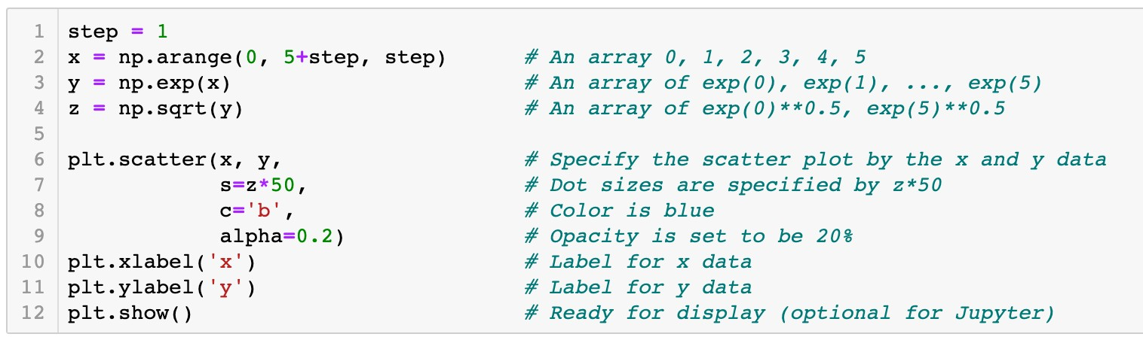
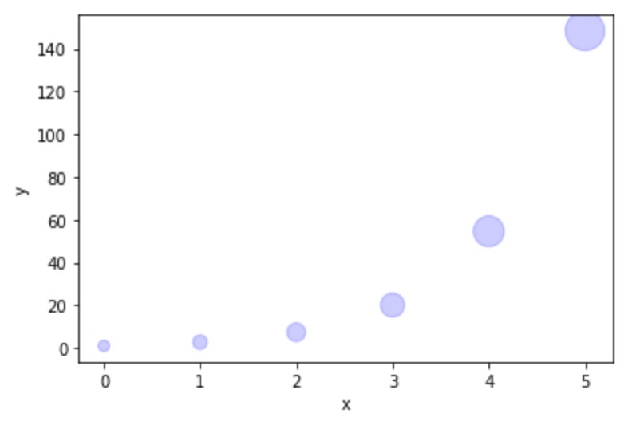
Data Visualization
Configuration of plots and figures
Specify the scatter plot by keyword arguments
Size of scatter dots

Slide 62
Data Visualization
Configuration of plots and figures
Specify the scatter plot by keyword arguments
Color of scatter dots

Slide 63
Data Visualization
Configuration of plots and figures
Specify the scatter plot by keyword arguments
Opacity of dots

Slide 64
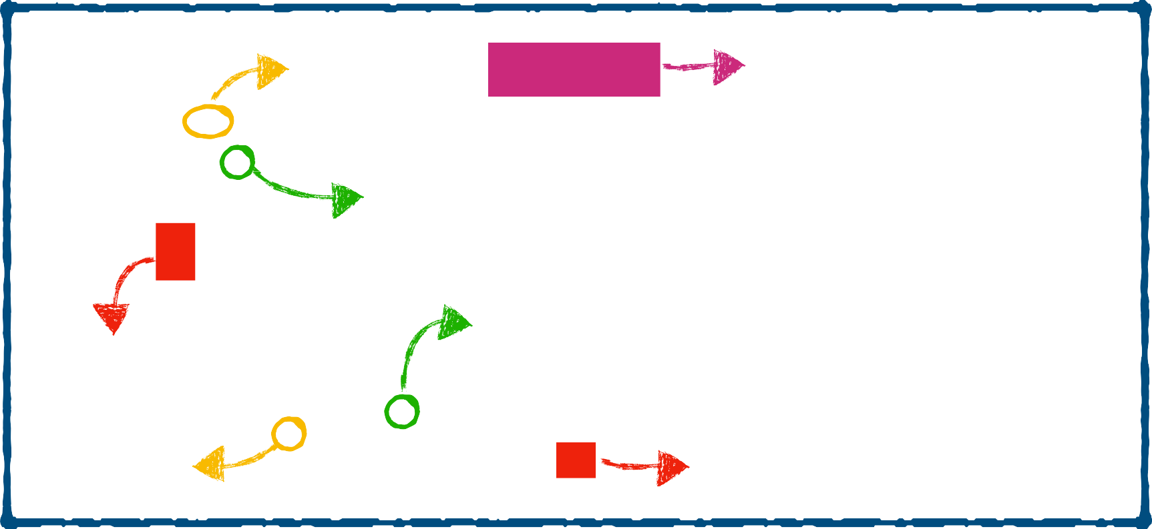
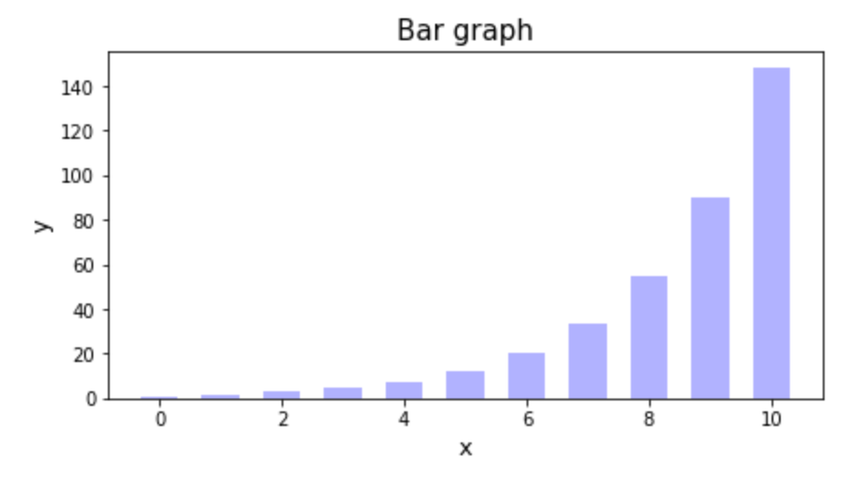
Data Visualization
Configuration of plots and figures
Components of a figure
Figure
yticklabel
title
yticks
xticks
ylabel
xticklabel
xlabel

Slide 65
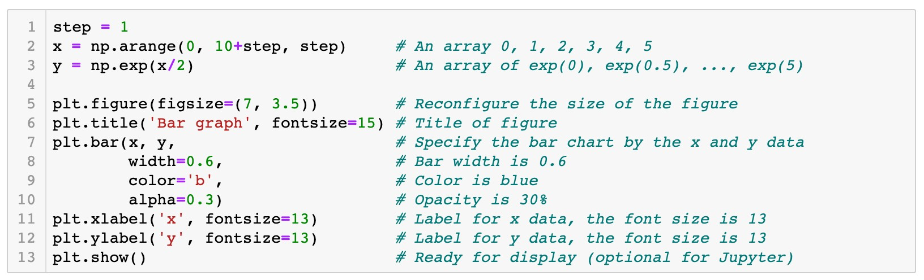

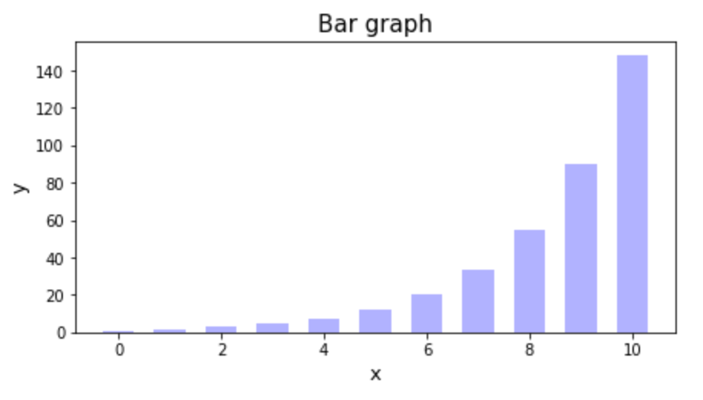
Data Visualization
Configuration of plots and figures
Attributes of a figure

Slide 66

Data Visualization
Configuration of plots and figures
Attributes of a figure
7
3.5

Slide 67
Data Visualization
Configuration of plots and figures
Attributes of a figure

Slide 68
Data Visualization
Configuration of plots and figures
Attributes of a figure

Slide 69

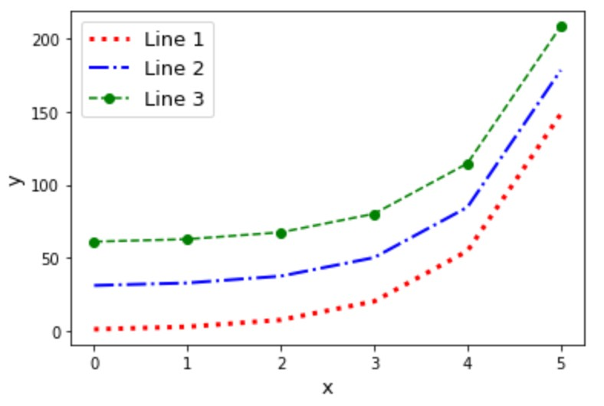

Data Visualization
Labeling plots and the function
legend()
legend

Slide 70
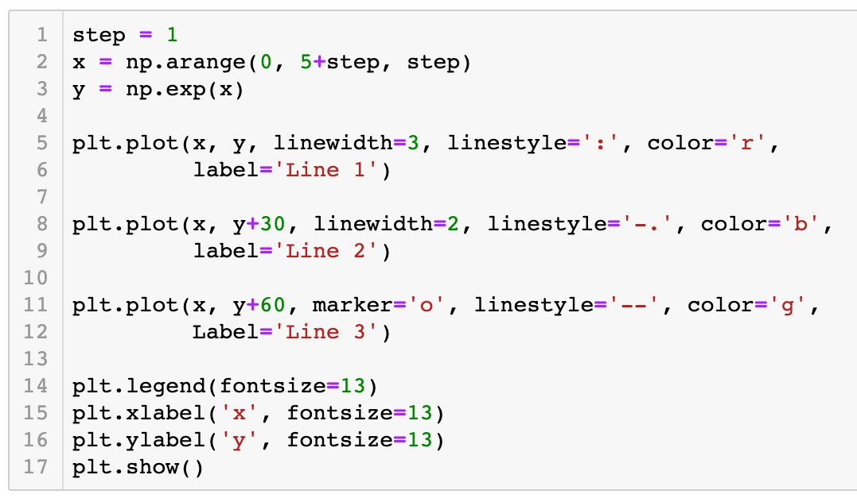


Data Visualization
Labeling plots and the function
Connection between plots and labels
legend()
legend

Slide 71


Python Packages
Packages NumPy and Matplotlib

Slide 72

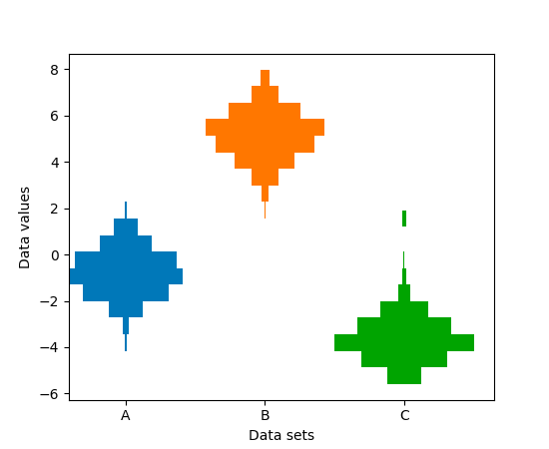

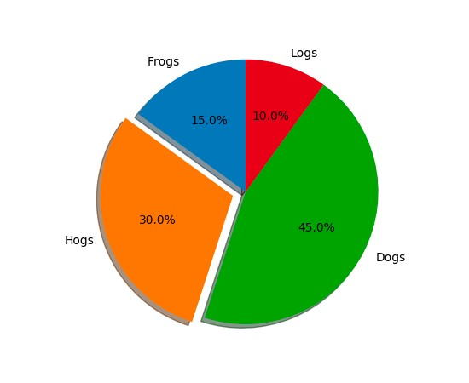

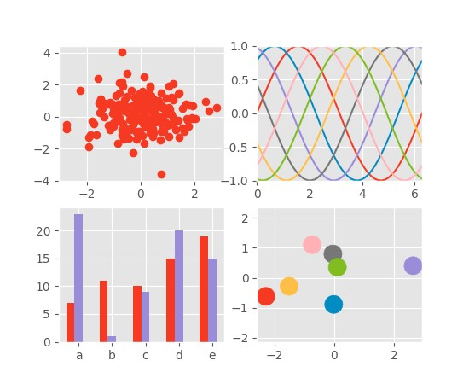
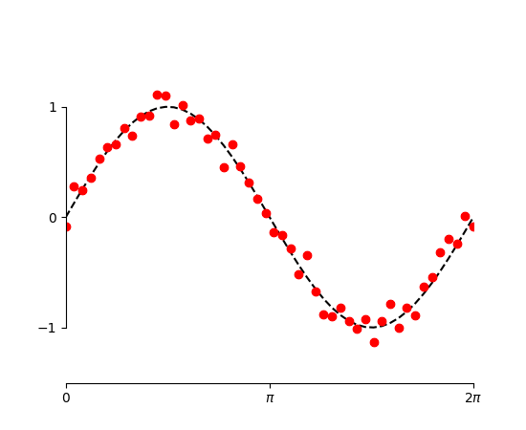
Python Packages
Packages NumPy and Matplotlib
‣
Matplotlib
thumbnail gallery: examples and demos

Slide 73
Roadmap
Array Data Structure
Data Visualization
Pandas

Slide 74
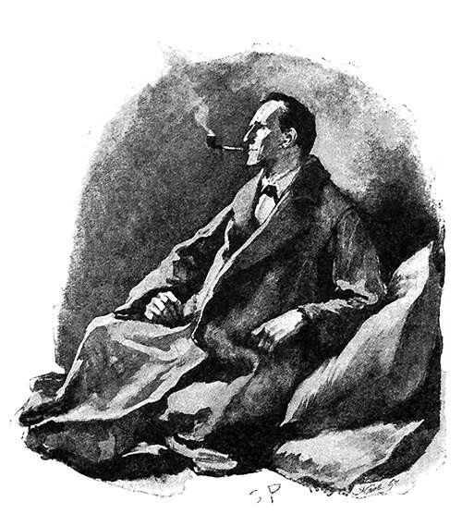
“It is a capital mistake to theorize before one has data. Insensibly one begins to twist facts to suit theories, instead of theories to suit facts.”
–Sherlock Holmes, A Scandal in Bohemia

Slide 75

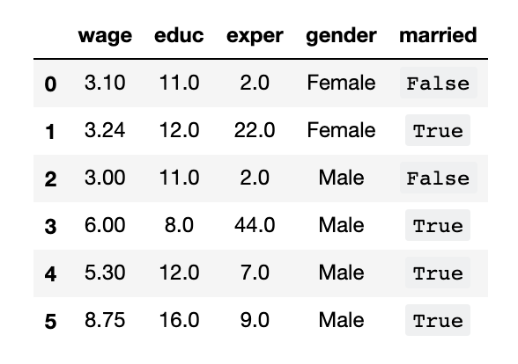
Datasets
Data representation
Example 1
The data table contains a cross-sectional dataset on a number of working individuals for the year 1976. Explore the dataset to gain some basic knowledge of the historical data.

Slide 76
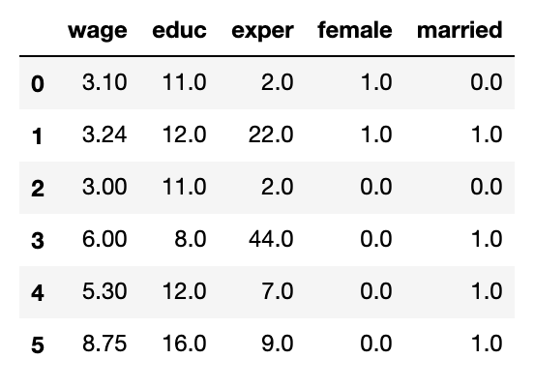
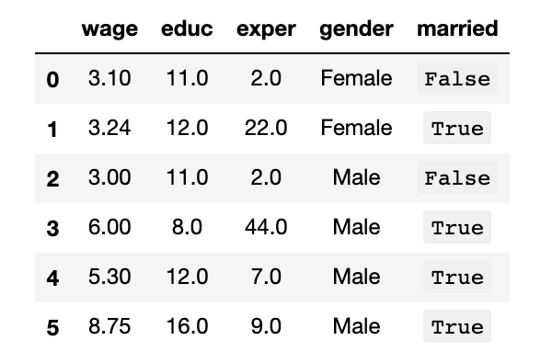
Datasets
Data representation
Variables (fields/attributes) as column labels
Years of education Average hourly
wage ($)
Years of working
experience
Gender
Marriage status

Slide 77
Datasets
Data representation
Variables (fields/attributes) as column labels
Observations (cases/records) as rows

Slide 78


Datasets
Data representation
Column index (label)
Row index (label)
Column index
Row index

Slide 79
Datasets
Types of variables
Numerical data
Categorical data
Numerical data Categorical data

Slide 80
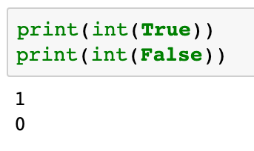
Datasets
Types of variables
Numerical (quantitative) data
Categorical (qualitative) data
Numerical data Categorical data

Slide 81
Pandas for Data Analysis
Introduction to Pandas
Labels for variables (or observations)
Heterogenous data
Possible missing values

Slide 82
Pandas for Data Analysis
Introduction to Pandas
pd
import pandas as
.<function name>
pd

Slide 83
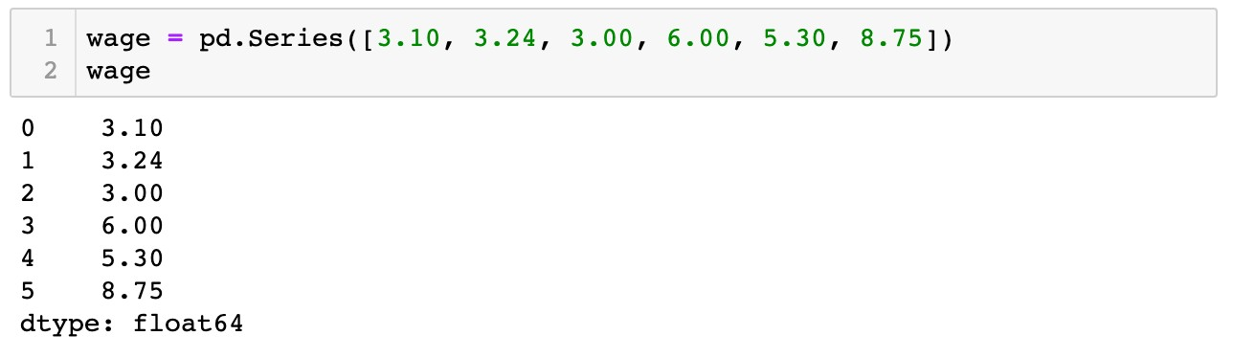

Pandas for Data Analysis
The
pandas.Series
data structure
A one-dimensional array of indexed data
Create a
pandas.Series
object

Slide 84


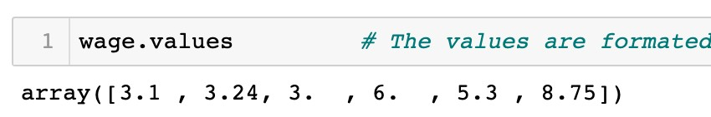
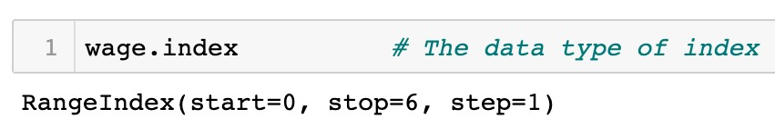
Pandas for Data Analysis
The
pandas.Series
data structure
A one-dimensional array of indexed data
Create a
pandas.Series
object

Slide 85
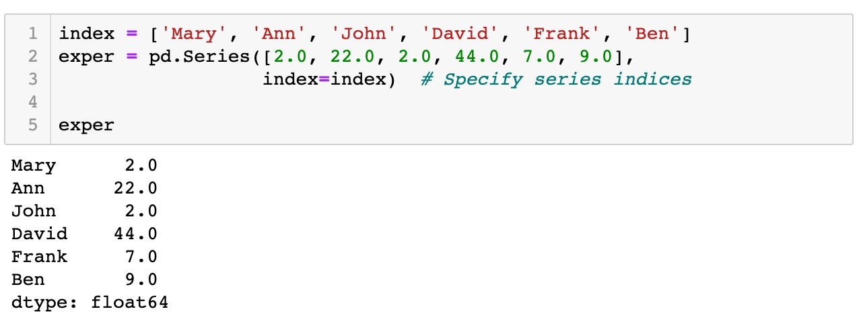

Pandas for Data Analysis
The
pandas.Series
data structure
A one-dimensional array of indexed data
Create a
pandas.Series
object
Values
Indices
exper.values
exper.index

Slide 86


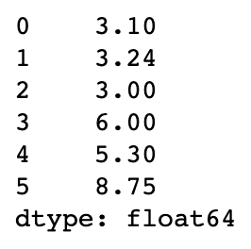
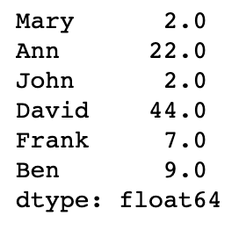


Pandas for Data Analysis
The
pandas.Series
data structure
Indexing and slicing of
pandas.Series
objects via brackets
[]
Label based indices
wage
exper
0
1
2
3
4
5
0
1
2
3
4
5
Integer-position based indices

Slide 87
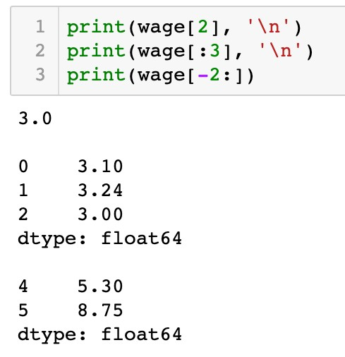
Pandas for Data Analysis
The
pandas.Series
data structure
Indexing and slicing of
pandas.Series
objects via brackets
[]
Label based indices are the same as integer-position based indices
wage
0
1
Integer-position based indices
2
3
4
5

Slide 88
Pandas for Data Analysis
The
pandas.Series
data structure
Indexing and slicing of
pandas.Series
objects via brackets
[]
Label based indices are the same as integer-position based indices
wage
0
1
2
Integer-position based indices
3
4
5

Slide 89
Pandas for Data Analysis
The
pandas.Series
data structure
Indexing and slicing of
pandas.Series
objects via brackets
[]
Label based indices are the same as integer-position based indices
wage
-6 |  | 0
-5 |  | 1
-4 |  | 2
-3 |  | 3
Integer-position based indices
-2 4
-1 5

Slide 90

Pandas for Data Analysis
The
pandas.Series
data structure
Indexing and slicing of
pandas.Series
objects via brackets
[]
Label based indices diﬀerent from integer-position based indices
exper
0
1
2
Label based indices
3
4
5

Slide 91
Pandas for Data Analysis
The
pandas.Series
data structure
Indexing and slicing of
pandas.Series
objects via brackets
[]
Label based indices diﬀerent from integer-position based indices
exper
0
1
2
Label based indices
3
4
5

Slide 92

Pandas for Data Analysis
The
pandas.Series
data structure
Indexing and slicing of
pandas.Series
objects via brackets
[]
Label based indices diﬀerent from integer-position based indices
exper
0
1
2
Label based indices
3
4
5

Slide 93
Pandas for Data Analysis
The
pandas.Series
data structure
Indexing and slicing of
pandas.Series
objects via brackets
[]
Label based indices diﬀerent from integer-position based indices
exper
0
1
2
Label based indices
3
4
5

Slide 94

Pandas for Data Analysis
The
pandas.Series
data structure
Indexing and slicing of
pandas.Series
objects via brackets
[]
Label based indices diﬀerent from integer-position based indices
exper
0
1
2
Label based indices
3
Notes
4
5
In the slicing expressions for label based indices, the
item indexed by stop are included in the selection. This is different from the list style slicing syntax we learned before.

Slide 95
Pandas for Data Analysis
The
pandas.Series
data structure
Indexing and slicing of
pandas.Series
objects via brackets
[]
Label based indices diﬀerent from integer-position based indices
exper
0
1
2
Label based indices
3
4
5

Slide 96

Pandas for Data Analysis
The
pandas.Series
data structure
Indexing and slicing of
pandas.Series
objects via brackets
[]
Label based indices diﬀerent from integer-position based indices
exper
0
1
Integer-position based indices
2
3
4
5

Slide 97
Pandas for Data Analysis
The
pandas.Series
data structure
Indexing and slicing of
pandas.Series
objects via brackets
[]
Label based indices diﬀerent from integer-position based indices
exper
0
1
Integer-position based indices
2
3
4
5

Slide 98
Pandas for Data Analysis
The
pandas.Series
data structure
Indexing and slicing of
pandas.Series
objects via brackets
[]
Label based indices diﬀerent from integer-position based indices
exper
-6
0
-5
1
Integer-position based indices
-4
2
-3 3
-2 4
-1 5

Slide 99
Pandas for Data Analysis
The
pandas.Series
data structure
Indexing and slicing of
pandas.Series
objects via brackets
[]
Label based indices diﬀerent from integer-position based indices
exper
0
1
Integer-position based indices
2
3
4
5

Slide 100








Pandas for Data Analysis
The
pandas.Series
data structure
Indexing and slicing of
pandas.Series
objects via brackets
[]
wage
exper
0
0
1
1
2
2
3
3
4
4
5
5

Slide 101



Pandas for Data Analysis
The
pandas.Series
data structure
Indexers:
loc[]
and
iloc[]
loc[]
wage
exper
0
1
2
3
4
5
0
1
2
3
4
5
iloc[]

Slide 102



Pandas for Data Analysis
The
pandas.Series
data structure
Indexers:
loc[]
and
iloc[]
exper
0
2
3
4
5
1

Slide 103


Pandas for Data Analysis
The
pandas.Series
data structure
Indexers:
loc[]
and
iloc[]
exper
0
1
2
3
4
5

Slide 104

Pandas for Data Analysis
The
pandas.Series
data structure
Indexers:
loc[]
and
iloc[]
exper
0
1
3
4
5
2

Slide 105


Pandas for Data Analysis
The
pandas.Series
data structure
Indexers:
loc[]
and
iloc[]
exper
0
1
3
5
2
4

Slide 106


Pandas for Data Analysis
The
pandas.Series
data structure
Indexers:
loc[]
and
iloc[]
wage
0
0
1
1
stop
2
is included
2
3
3
4
5
4
5

Slide 107

Pandas for Data Analysis
The
pandas.Series
data structure
Indexers:
loc[]
and
iloc[]
wage
0
1
0
1
2
stop
2
is excluded
3
4
5
3
4
5

Slide 108
Pandas for Data Analysis
The
pandas.Series
data structure
Indexers:
loc[]
and
iloc[]
Label based indices are expressed by index included in the selection
loc[]
, with the
stop
Integer-position based indices are expressed by
iloc[]
with the
stop
index excluded from the selection
Coding Style
One guiding principle of Python code is that "explicit is better than implicit." The explicit nature of and make them very useful in maintaining clean and readable code; especially in the case of integer indexes.
loc[]
iloc[]

Slide 109


Pandas for Data Analysis
The
Create a
pandas.DataFrame
data structure
pandas.DataFrame
object

Slide 110

Pandas for Data Analysis
The
Create a
pandas.DataFrame
data structure
pandas.DataFrame
object
Constructor

Slide 111


Pandas for Data Analysis
The
pandas.DataFrame
data structure
Create a
pandas.DataFrame
object
Column index
data_frame.columns

Slide 112


Pandas for Data Analysis
The
Create a
pandas.DataFrame
data structure
pandas.DataFrame
object
Row index
data_frame.index

Slide 113
Pandas for Data Analysis
The
Create a
pandas.DataFrame
data structure
pandas.DataFrame
object

Slide 114



Pandas for Data Analysis
The
Create a
pandas.DataFrame
data structure
pandas.DataFrame
object

Slide 115
Pandas for Data Analysis
The
pandas.DataFrame
data structure
Accessing columns and rows via brackets
[]
Columns: a single column index or a list of column indices

Slide 116


Pandas for Data Analysis
The
pandas.DataFrame
data structure
Accessing columns and rows via brackets
[]
Columns:
a single column index
or a list of column indices

Slide 117

Pandas for Data Analysis
The
pandas.DataFrame
data structure
Accessing columns and rows via brackets
[]
Columns: a single column index or
a list of column indices

Slide 118
Pandas for Data Analysis
The
pandas.DataFrame
data structure
Accessing columns and rows via brackets
[]
Rows: a slicing expression of the label based or integer-position based indices

Slide 119


Pandas for Data Analysis
The
pandas.DataFrame
data structure
Accessing columns and rows via brackets
[]
Rows:
a slicing expression
of the label based or integer-position
2

Slide 120

Pandas for Data Analysis
The
pandas.DataFrame
data structure
Accessing columns and rows via brackets
[]
Rows:
a slicing expression
of the label based or integer-position

Slide 121








Pandas for Data Analysis
The
pandas.DataFrame
data structure
Accessing columns and rows via brackets
Question
[]
Given a data table, how to access the highlighted subset? A.
B.
C.
D.
E.
F.

Slide 122
Pandas for Data Analysis
The
pandas.DataFrame
data structure
Accessing columns and rows via brackets
[]
Columns: a single column index or a list of column indices
Rows: of the label based or integer-position based indices
a slicing expression

Slide 123

Pandas for Data Analysis
The
pandas.DataFrame
data structure
Indexers:
loc[]
and
iloc[]

Slide 124





Pandas for Data Analysis
The
pandas.DataFrame
data structure
Indexers:
loc[]
and
iloc[]
Integer-position based column indices
Integer-position based row indices
1 2
0 3
4
0
1
2
3
4
5

Slide 125



Pandas for Data Analysis
The
pandas.DataFrame
data structure
Indexers:
loc[]
and
iloc[]
Integer-position based column indices
Integer-position based row indices
1 2
0 3
4
0
1
2
3
4
5

Slide 126

Pandas for Data Analysis
The
pandas.DataFrame
data structure
Indexers:
loc[]
and
iloc[]
Label based column indices
Label based row indices

Slide 127


Pandas for Data Analysis
The
pandas.DataFrame
data structure
Indexers:
loc[]
and
iloc[]
Label based column indices
Label based row indices
Notes
In the slicing expressions for label based indices (loc[]), the item indexed by stop are included in the selection. This is different from the list style slicing syntax we learned before.

Slide 128


Pandas for Data Analysis
The
pandas.DataFrame
data structure
Indexers:
loc[]
and
iloc[]
Access all rows or columns via
:
0
1
2
3
4
All rows
Column indices

Slide 129


Pandas for Data Analysis
The
pandas.DataFrame
data structure
Indexers:
loc[]
and
iloc[]
Access all rows or columns via
:
All columns
All indices

Slide 130


Pandas for Data Analysis
The
pandas.DataFrame
data structure
Indexers:
loc[]
and
iloc[]
Access all rows or columns via
:
All columns as default
All indices

Slide 131

Pandas for Data Analysis
The
Indexers:
pandas.DataFrame
data structure
loc[]
and
iloc[]
Data types of indices

Slide 132

Pandas for Data Analysis
The
Indexers:
pandas.DataFrame
data structure
loc[]
and
iloc[]
Data types of indices
0
1
2
3
4

Slide 133

Pandas for Data Analysis
The
Indexers:
pandas.DataFrame
data structure
loc[]
and
iloc[]
Data types of indices
0
1
2
3
4

Slide 134
Pandas for Data Analysis
The
pandas.DataFrame
data structure
Modify a subset of a
pandas.DataFrame
object
Similar to modifying a part of a built-in compound data object (list/dictionary)

Slide 135






Pandas for Data Analysis
The
Modify a subset of a
data structure
object
pandas.DataFrame
pandas.DataFrame

Slide 136





Pandas for Data Analysis
The
pandas.DataFrame
data structure
Modify a subset of a
pandas.DataFrame
object
0
1 2
3
4
0
1 2
3
4
0
0
1
1
2
2
3
3
4
4
5
5

Slide 137




Pandas for Data Analysis
The
pandas.DataFrame
data structure
Modify a subset of a
pandas.DataFrame
object
New label added as a new column

Slide 138
Pandas for Data Analysis
The
Boolean
pandas.DataFrame
data structure
and boolean indexing
pandas.Series
A subset for female workers?

Slide 139

Pandas for Data Analysis
The
Boolean
pandas.DataFrame
data structure
and boolean indexing
pandas.Series

Slide 140

Pandas for Data Analysis
The
Boolean
pandas.DataFrame
data structure
and boolean indexing
pandas.Series
is_female
=='Female'
=='Female'
=='Female'
=='Female'
=='Female'
=='Female'
TRUE TRUE FALSE FALSE FALSE FALSE

Slide 141


Pandas for Data Analysis
The
Boolean
pandas.DataFrame
data structure
and boolean indexing
pandas.Series
is_high_wage
> 4
> 4
> 4
> | 4
> | 4
> | 4
FALSE FALSE FALSE TRUE TRUE TRUE

Slide 142


Pandas for Data Analysis
The
Boolean
pandas.DataFrame
data structure
and boolean indexing
pandas.Series
is_wife
TRUE TRUE TRUE FALSE FALSE FALSE
FALSE TRUE FALSE TRUE TRUE TRUE
FALSE TRUE FALSE FALSE FALSE FALSE
&

Slide 143

Pandas for Data Analysis
The
Boolean
pandas.DataFrame
data structure
and boolean indexing
pandas.Series
is_female
TRUE TRUE
FALSE
FALSE
FALSE
FALSE

Slide 144

Pandas for Data Analysis
The
Boolean
pandas.DataFrame
data structure
and boolean indexing
pandas.Series

Slide 145



Pandas for Data Analysis
The
Boolean
pandas.DataFrame
data structure
and boolean indexing
pandas.Series
is_wife
FALSE
TRUE
FALSE
FALSE
FALSE
FALSE

Slide 146
Pandas for Data Analysis
The
Boolean
pandas.DataFrame
data structure
and boolean indexing
pandas.Series
is_wife
FALSE
TRUE
FALSE
FALSE
FALSE
FALSE

Slide 147

Pandas for Data Analysis
The
pandas.DataFrame
data structure
Boolean
pandas.Series
and boolean indexing
Question
Please change values of the column “remarks” by yourself according to the following rule:
The value for married male is changed to the string 'Husband';
The value for unmarried male or female is changed to the string ‘Single'.

Slide 148
Roadmap
Array Data Structure
Data Visualization
Pandas

